Slide 1
Remaining Useful Life Prediction of Cutting Tools Based on Support Vector Regression
Structure
Discovery
Image
Classification
Feature
Elicitation
Customer
Retention
Meaningful
Compression
Fraud
Detection
DIMENSIONALLY
REDUCTION
CLASSIFICATION
Big Data
Visualization
Diagnostics
Forecasting
Recommended
Systems
UNSUPERVISED
LEARNING
SUPERVISED
LEARNING
Predictions
CLASTERING
REGRESSION
Targeted
Marketing
MACHINE
LEARNING
Process
Optimization
Customer
Segmentation
New Insights
REINFORCEMENT
LEARNING
Real-Time Decisions
Robot Navigation
Game Ai
Skill Acquisition
Learning Tasks

Slide 2
Presentation By
TEJAS BHATAMBAREKAR (181080016)
KAPIL BHISE (181080017)
PRATHMESH CHANDWADE (181080018)
GAURAV CHAMBHARE (181080025)
TY BTECH IT
IN
INFORMATION TECHNOLGY
AT
VEERMATA JIJABAI TECHNOLOGICAL INSTITUTE
Department of CE & IT
MUMBAI
MAY 2021

Slide 3

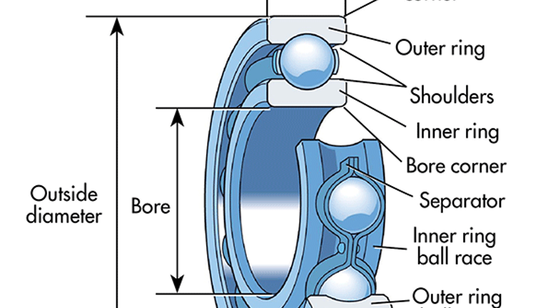
Problem Statement
Remaining useful life (RUL) prediction of cutting tools is critical to effective condition based maintenance for reducing downtime, ensuring quality and avoiding accidents.
In this paper, a RUL prognostic method based on support vector regression (SVR) is proposed for predicting cutting tool’s life.
The proposed method consists of two main phases: an off-line phase and an on-line phase.

Slide 4
Problem Statement
Problem Statement
In the first phase, the signal features are extracted from raw data, and then the SVR models with considering different length of signals at past times are established to reflect the relationship between monitoring data and tool life.
In the second phase, the constructed models are used to predict the cutting tool’s RUL, and the best signal length for accurate prediction result is obtained. The proposed method is applied on experimental data taken from a computer numerical control (CNC) rotor slot machine in a factory. The result shows the validity and practicability of this method.

Slide 5
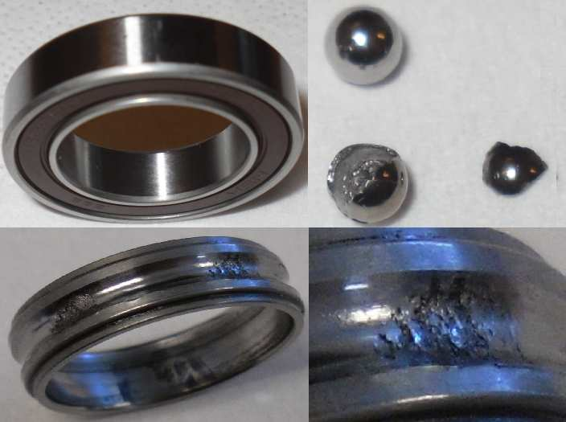
Motivation
For our project we wished to implement the knowledge that we have learned from class as well as learning various new techniques and approaches we can take in the process of creating a fine working model.
While searching appropriate topics of interest from various research papers, we came across our current topic.
We became interested by reading the content of said research paper and decided to select it as one of our topics for recommendations dataset.

Slide 6
Motivation
For Remaining Useful Life prediction, various methods have been proposed in literature. Support Vector Regression is one of these methods. Support Vector Regression is a regression algorithm that supports both linear and non-linear regressions.
In our project, we are estimating RUL of ball bearings based on IEEE PHM 2012. We have learnt Support Vector Regression during Machine Learning course, and this motivated us to further study about it. We referred a research paper in SVR
applied for RUL prediction of cutter.
This helped us in determining our approach of using SVR in RUL prediction of given dataset.

Slide 7
Methodology
We have used a two-step approach for RUL estimation based on the research
paper referred to.
The first step involves extraction of features from vibration data from the dataset.
The features extracted from the dataset are as follows:
1. Root Mean Square (RMS)

Slide 8
Methodology
2. Amplitude
We normalized the extracted features using the min-max method for better applicability in the model.
In the second step, we developed a SVR model based on the normalized values of features. We trained the model using a learning dataset.
The developed model was then applied to a test dataset for RUL estimation.
We have used the SVR model with kernels. The common kernel functions
used for SVR approaches are linear, polynomial and RBF. Literature suggests that RBF performs better than other kernels in most of the cases. Thus, we have used the RBF kernel for the SVR model.
We have used following values for parameters of SVRmodel using RBF
kernel:
ε = 0.1, C = 4, γ = 0.5

Slide 9
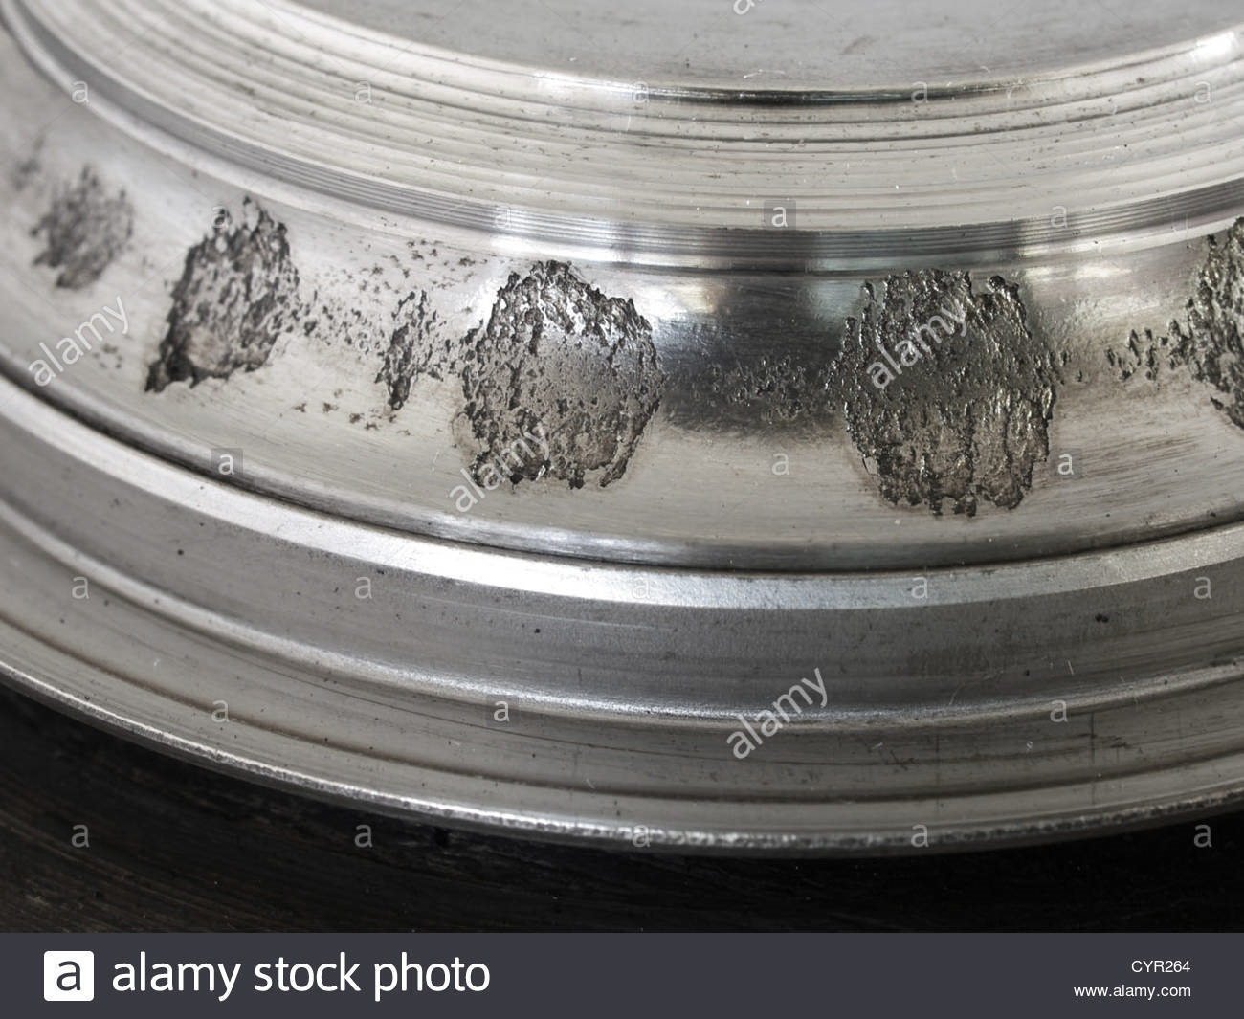
Contribution
We contributed in the project in the following manner:
1. Feature Extraction:
We decided on the features to be used for the model.
We researched for a way to extract feature from given dataset
We extracted the features from the dataset.
We defined functions for feature extraction and extracted features for learning and
testing dataset.

Slide 10
Contribution
2. Model Selection:
In the SVR model, various kernels can be used. Literature suggests using RBF
kernel. We verified it by running models based on linear, polynomial and RBF
kernels and concluded that RBF gives best fitting.
We ran the SVR model using the RBF kernel.
3. Calculating score:
We trained the model using a learning set and used it on the training set and
calculated accuracy score for the outcome.

Slide 11
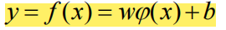
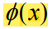
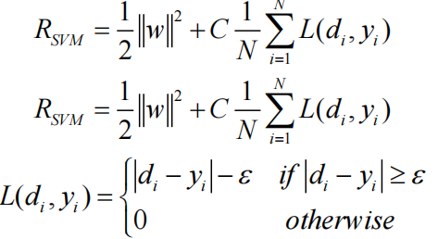
What is SVR?
The main objective of SVR is to map the data into a higher dimensional feature space and to estimate a relationship between input and output random variables under the assumption that the joint distribution of the variables is completely unknown.
The regression function can be expressed ..(1)
where denotes the high dimensional space transformation of AE features, and b are the coefficients.
The coefficients are estimated by minimizing the following regularized risk function:
..(2)
..(3)
..(4)

Slide 12
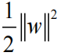
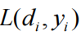
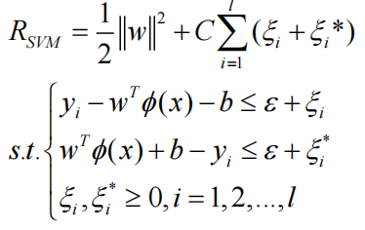
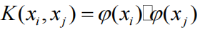
where is the regularized term, is the -insensitive loss function, is the tube size of SVM, and C is the regularization constant determining the trade-off between the empirical error and the regularized term. Two variables and are introduced to representing the distance from desired values to the corresponding boundary values of the -tube, and the Eq. (2) can be rewritten as: ..(5)
By introducing Lagrange multipliers and kernel function , the dual Lagrange form of Eq. (4) is given by:

Slide 13
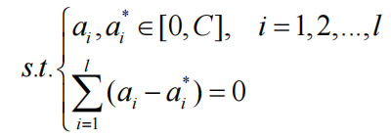
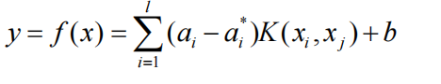
..(6)
Finally, the regression function Eq. (1) is transformed into:
..(7)

Slide 14
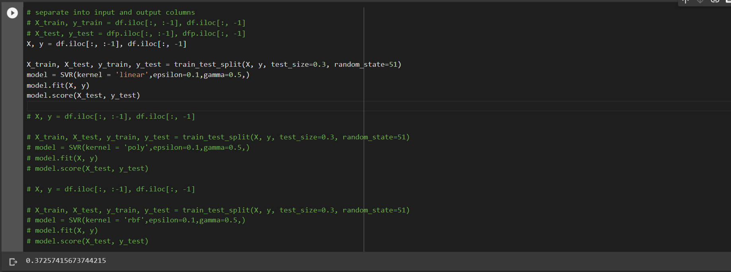
Score using Linear kernel

Slide 15
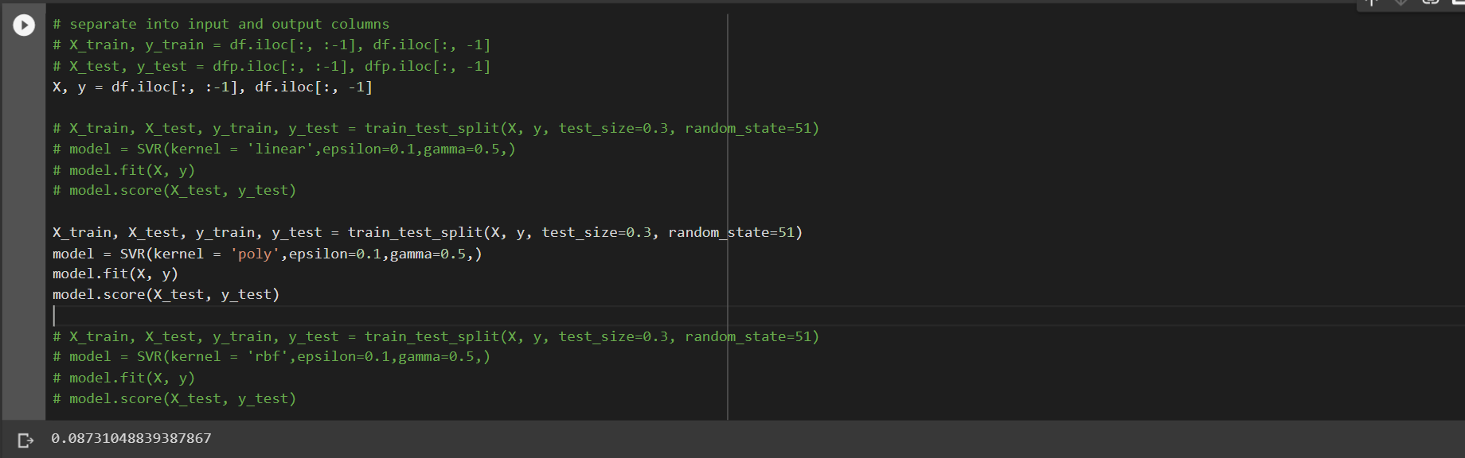
Score using poly kernel

Slide 16
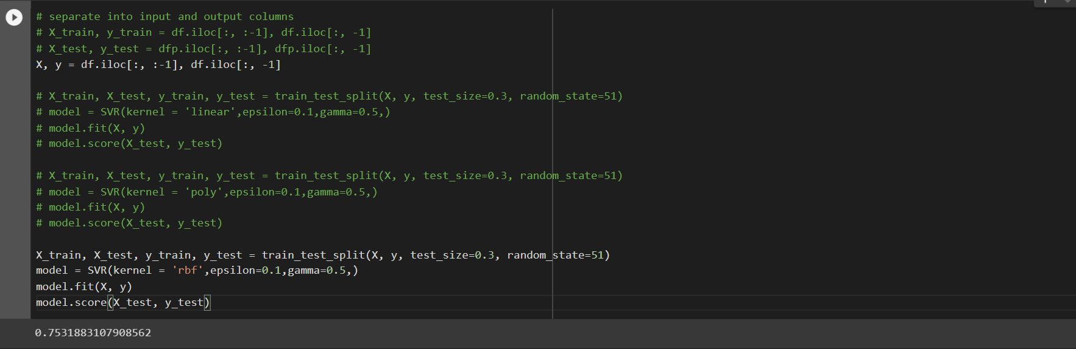
Score using RBF kernel

Slide 17
Discussion
First of all, we researched for a way to extract given features from the given dataset.
We checked all of the referred papers as well but couldn’t find any legible formulae.
Then we got the formula for RMS calculation from the vibrational energy which was one of the given parameters.
We then extracted RMS and amplitude and created our dataset.
Then using these features we created a svr model using linear, polynomial and RBF kernels.
We observed that the score prediction of RBFkernel was at par from linear and polynomial. So we decided to continue with the RBF kernel.

Slide 18
Discussion
Based on our assumption, we decided to pick a single training set and split it into testing and training sets. We calculated the accuracy of 75.31% for the same.
We faced a difficulty because our research paper had assumed that RUL of the training data was already provided which was not true in our case so we calculated the RUL of given bearing in a case as the final recording time - current case recording time.
Here, we assume that after the final recording time, bearing is worn out. From this project, we have gained thorough knowledge of how research papers are published and contents and format of the same.

Slide 19
Conclusion
We have also gained insights in the research field and read various research papers from different authors.

